Slide 1

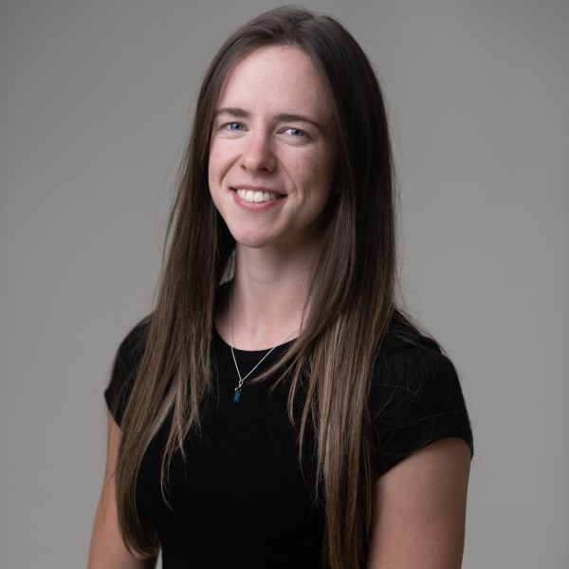
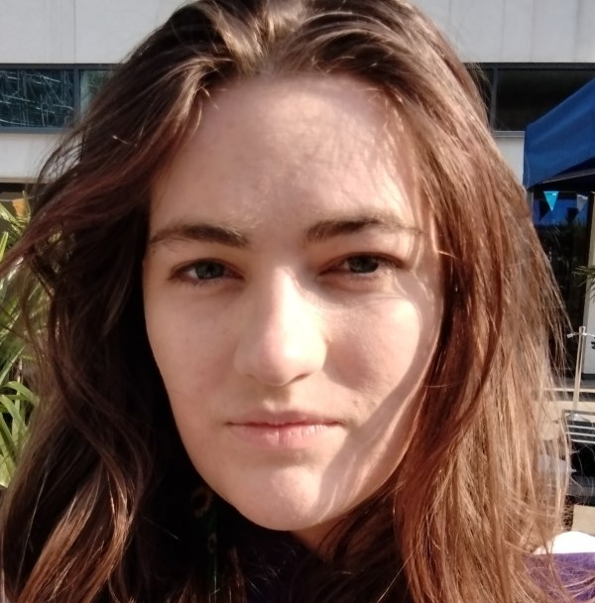

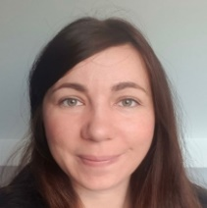
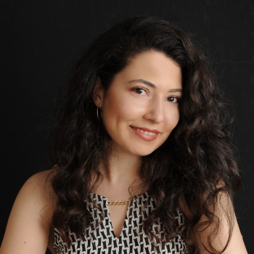
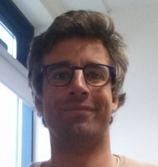
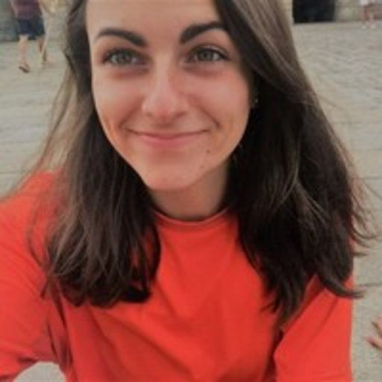


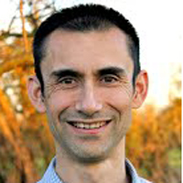
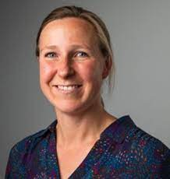
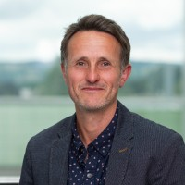
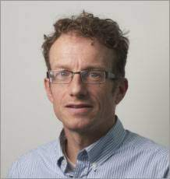
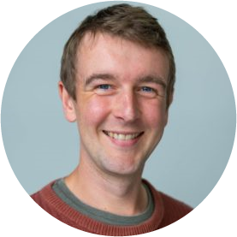
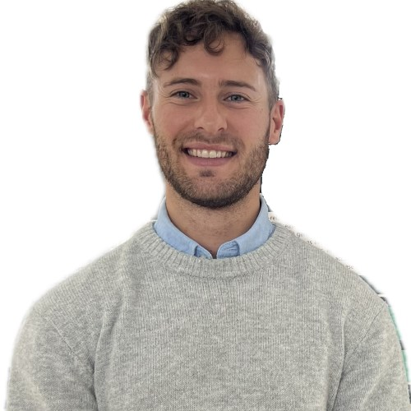

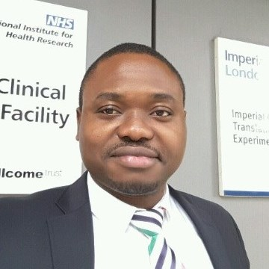

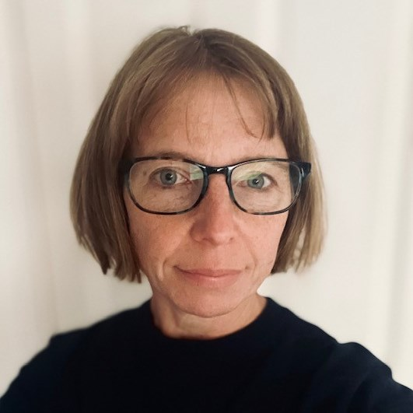

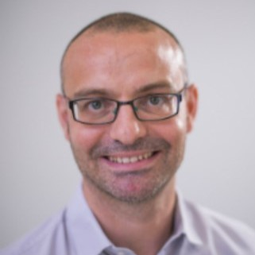
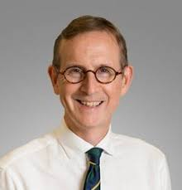
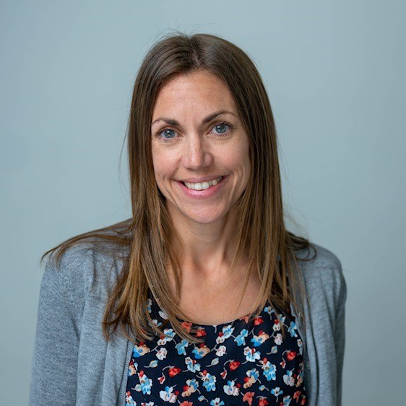



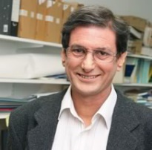
Luke C. Pilling, PhD
GEMINI team Bethany Voller Olivia Murrin Ruby Woodward Dr Ninon Mounier Dr Deniz Türkmen Dr João Delgado
Dr Lucía Carrasco
Dr Concepción Violán Prof Frank Dudbridge Prof Jane Masoli
Prof Jack Bowden Prof Tim Frayling (PI)
Department of Clinical and Biomedical Sciences
Genetic Insights into Ageing and Chronic Disease: Pathways, Penetrance, and Multimorbidity
Et al…!
Senior Lecturer in Genetic Epidemiology, University of Exeter, UK
Team Iron Mitchell Lucas Daniel Williamson Lucy Banfield Dr Francesco Casanova Dr Jeremy Shearman Dr Janice Atkins Prof David Melzer
L.Pilling@exeter.ac.uk
lcpilling.github.io
lcpilling.bsky.social
27 March 2025 @ UNIL DBC

Slide 2
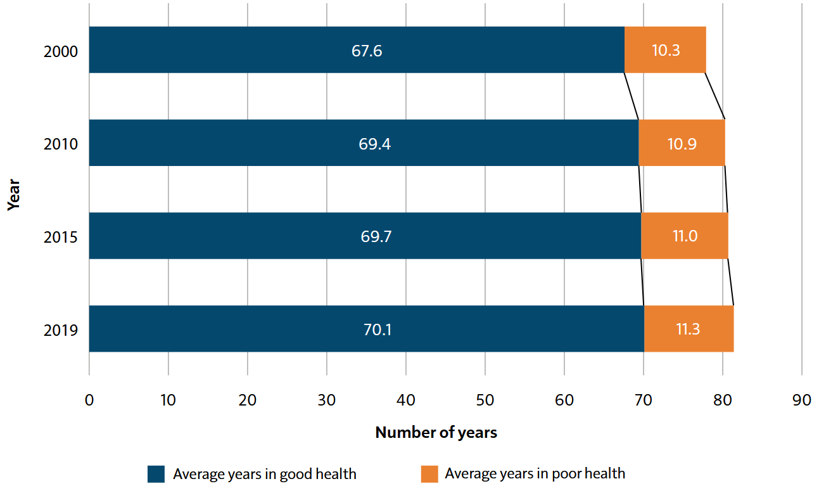
Despite improvements in longevity, the proportion of life spent in poorer health has changed little
Estimated number of years spent in good health and poorer health in the UK, 2000 to 2019
UK Chief Medical Officer’s 2023 Annual Report: Health in an Ageing Society
Source data: World Health Organization, The Global Health Observatory - Life expectancy and Healthy life expectancy

Slide 3
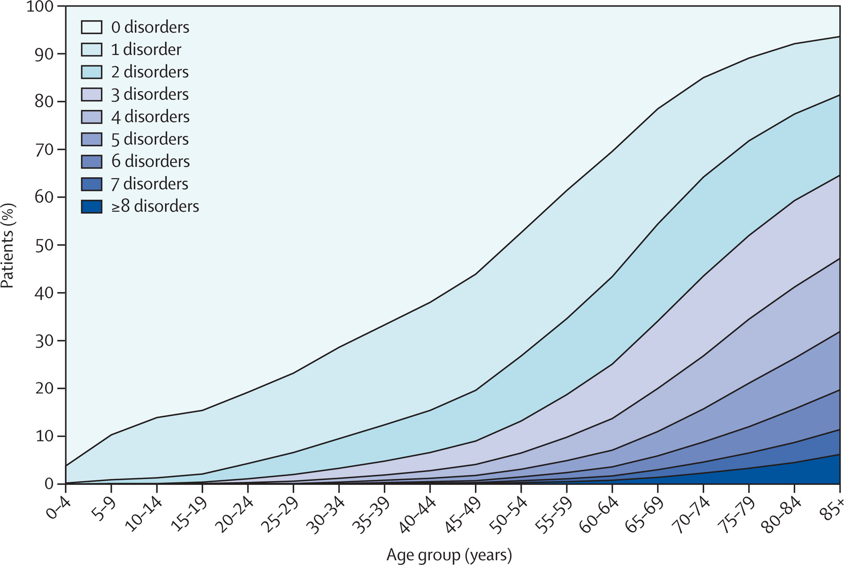
Ageing and accumulation of chronic diseases [multimorbidity]
Number of concurrent chronic disorders by age-group
Data on 40 morbidities from a database of 1,751,841 people registered with 314 medical practices in Scotland in March 2007
Barnett et al. “Epidemiology of multimorbidity and implications for health care, research, and medical education: a cross-sectional study” The Lancet, 2012. doi:10.1016/S0140-6736(12)60240-2

Slide 4
Medicine traditional treats disease individually
Yet diseases may share risk factors, interact in patients, or have competing treatments
UK Chief Medical Officer’s 2023 Annual Report: Health in an Ageing Society
Source data: Global Burden of Disease Study 2019 (GBD 2019), Institute for Health Metrics and Evaluation (2020)

Slide 5
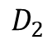
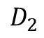
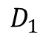
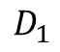
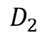
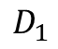
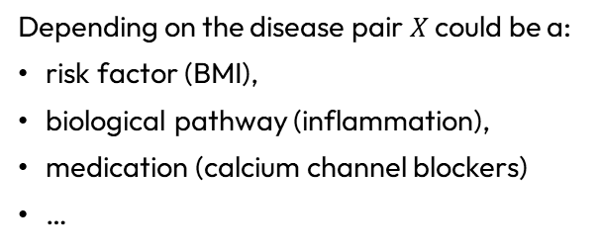
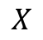
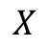
Multimorbidity and causal pathways
For a particular pair of diseases that co-occur in patients – what is the link?
$$D_{1}$$
$$D_{2}$$
$$D_{1}$$
$$D_{2}$$
$$D_{1}$$
$$D_{2}$$
$$X$$
$$X$$
Depending on the disease pair $X$ could be a:
risk factor (BMI),
biological pathway (inflammation),
medication (calcium channel blockers)
…

Slide 6
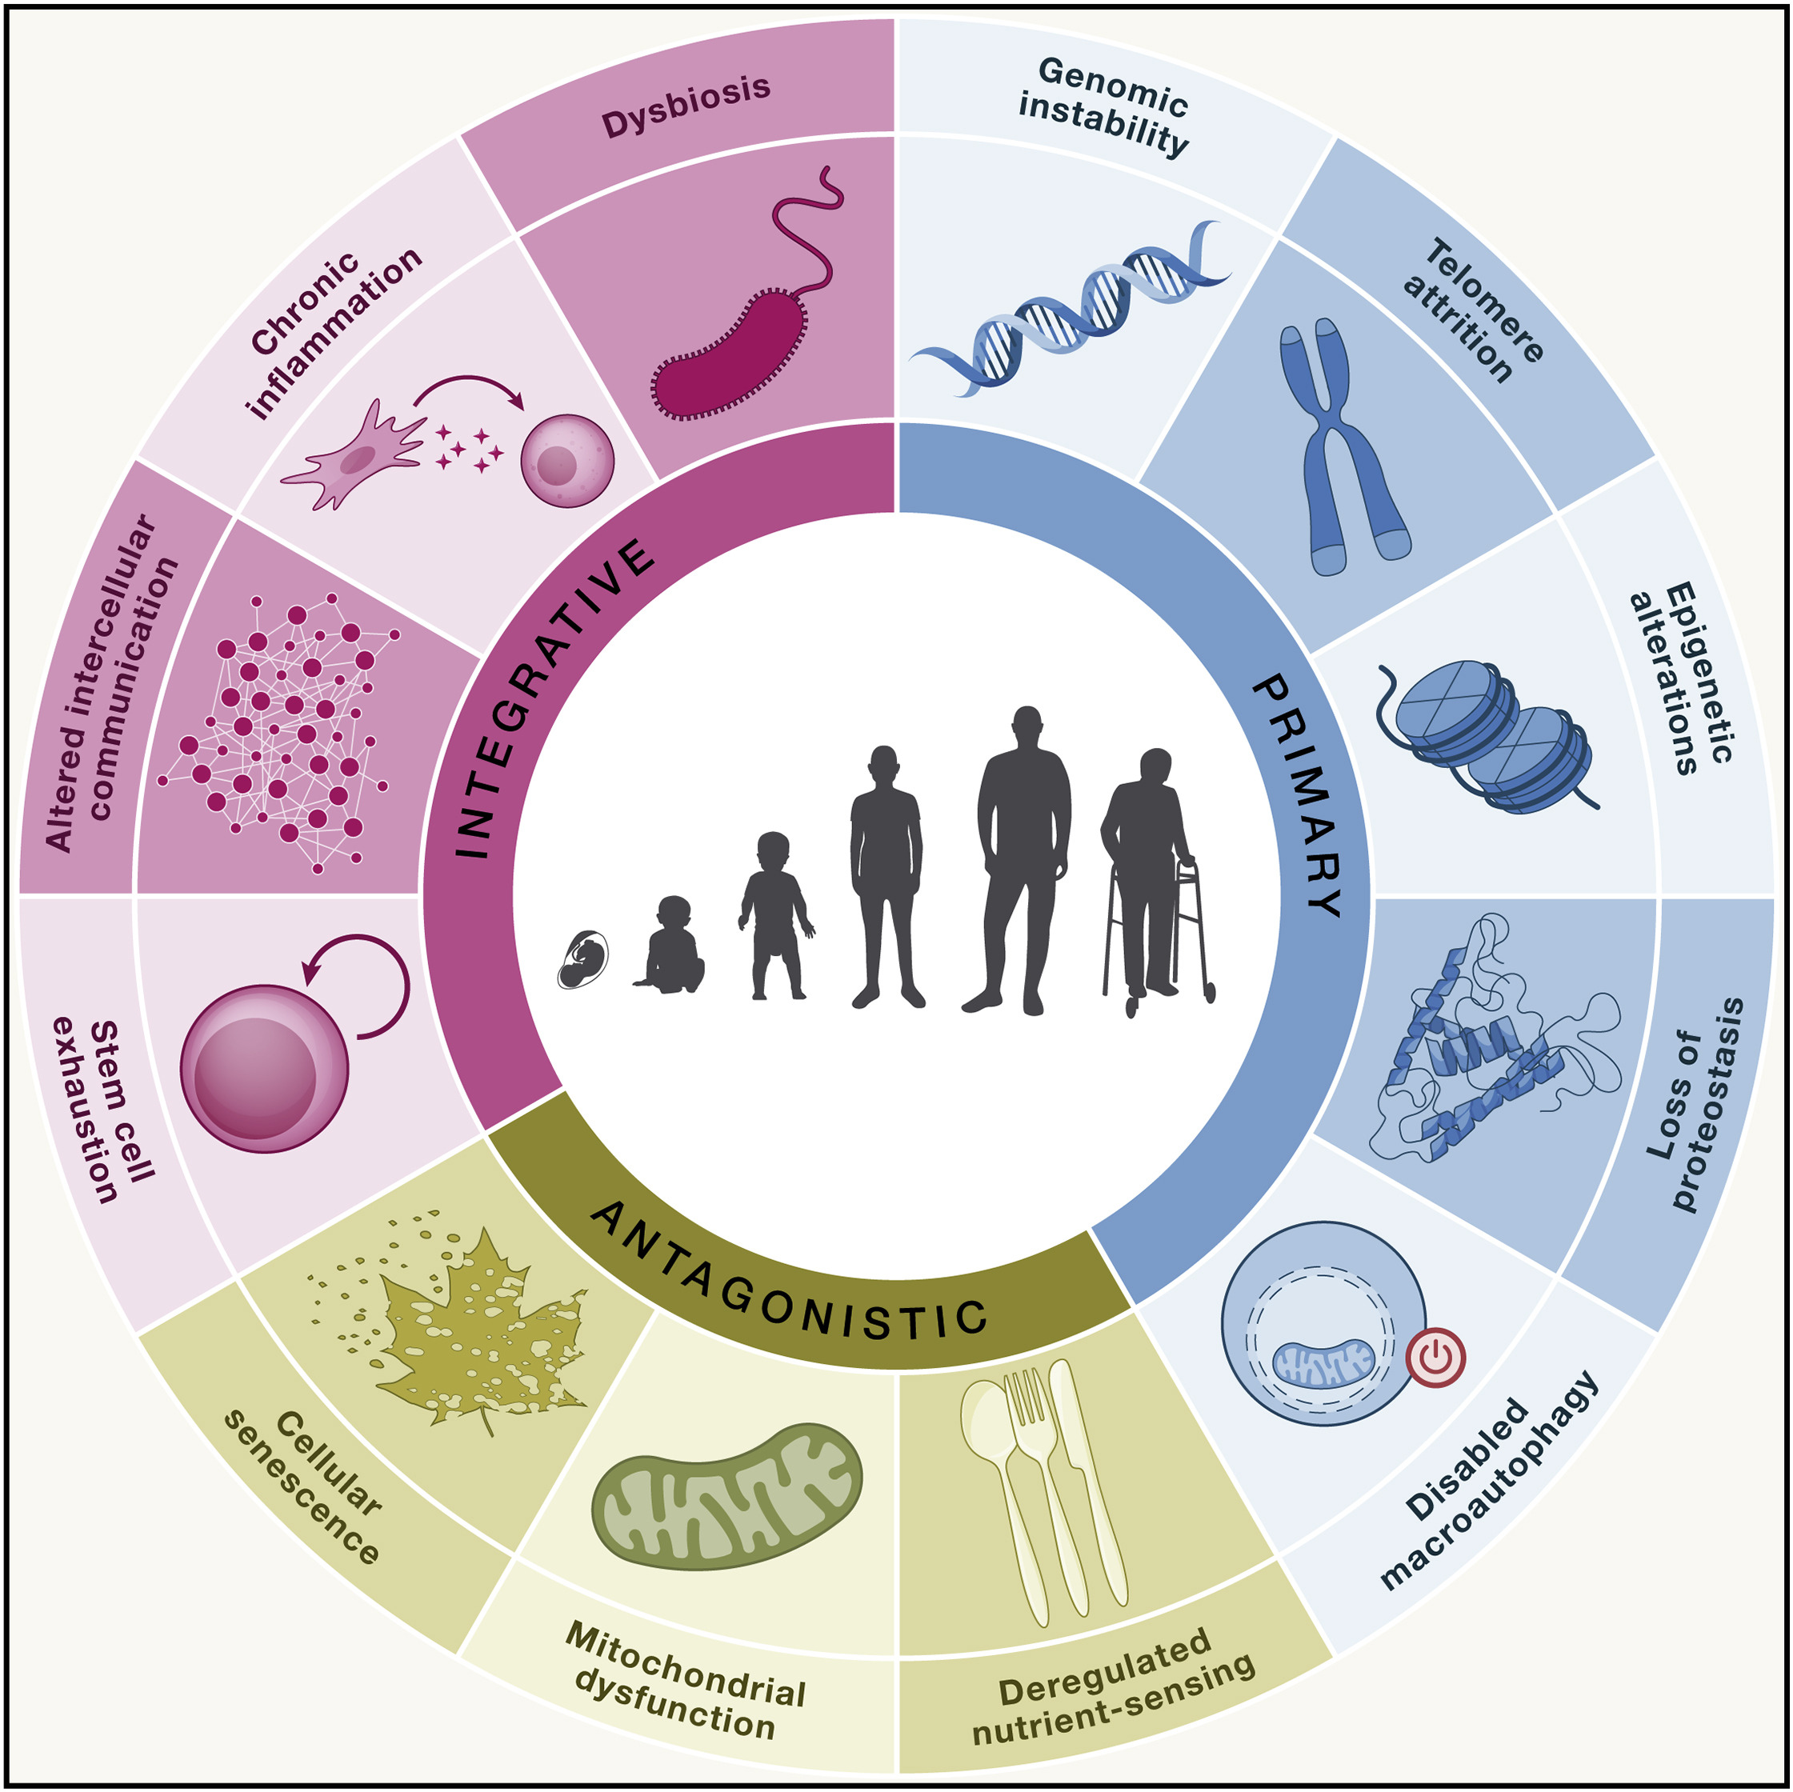
Biology of Ageing
Twelve proposed “hallmarks” of ageing [molecular, cellular, and systemic] – impact overall health and resilience of organisms
López-Otín et al. “Hallmarks of aging: An expanding universe” Cell, 2023. doi:10.1016/j.cell.2022.11.001

Slide 7
Luke C. Pilling, PhD
GEMINI team Bethany Voller Olivia Murrin Ruby Woodward Dr Ninon Mounier Dr Deniz Türkmen Dr João Delgado
Dr Lucía Carrasco
Dr Concepción Violán Prof Frank Dudbridge Prof Jane Masoli
Prof Jack Bowden Prof Tim Frayling (PI)
“GEMINI”
MR/W014548/1
PI: Prof Tim Frayling
Department of Clinical and Biomedical Sciences
Thank you!
“Ageing Well”
MR/M023095/1
PI: Prof David Melzer
L.Pilling@exeter.ac.uk
lcpilling.github.io
lcpilling.bsky.social
Resources
Et al…!
Team Iron Mitchell Lucas Daniel Williamson Lucy Banfield Dr Francesco Casanova Dr Jeremy Shearman Dr Janice Atkins Prof David Melzer
github.com/GEMINI-multimorbidity
gemini-multimorbidity.shinyapps.io/atlas
NIHR301844
PI: Dr Janice Atkins
sites.exeter.ac.uk/ironoverload
Research Contract
PI: Dr Luke Pilling
MR/S009892/1
PI: Prof David Melzer

Slide 9
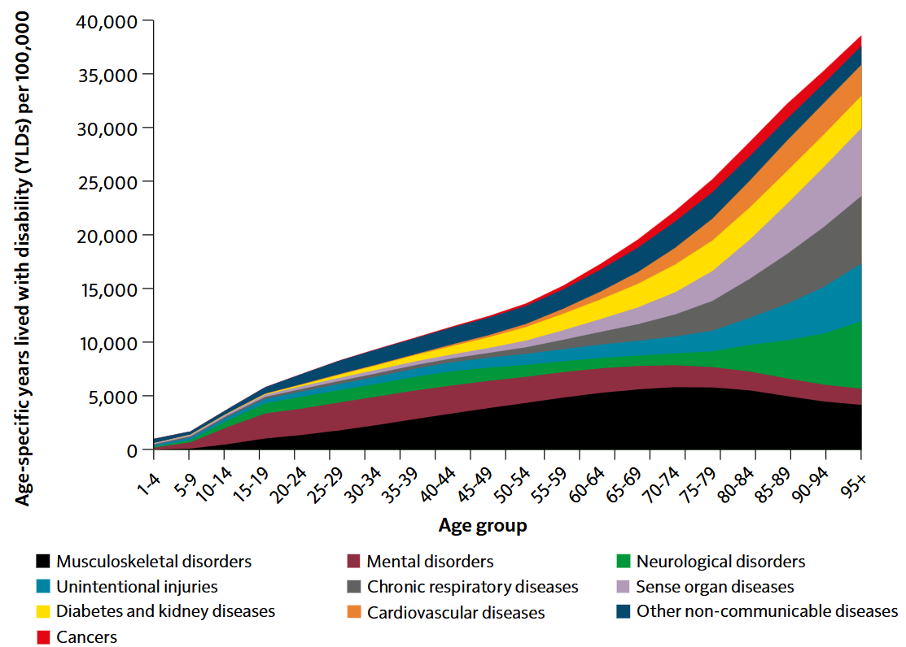
Ageing and accumulation of chronic diseases
Morbidity rate by age and top 10 broad causes (age-specific years lived with disability, persons England, in 2019)
UK Chief Medical Officer’s 2023 Annual Report: Health in an Ageing Society
Source data: Global Burden of Disease Study 2019 (GBD 2019), Institute for Health Metrics and Evaluation (2020)

